Slide 1
Consumer buying Process
Lesson -11-

Slide 2
The Complex Nature of Consumer Buying Process
The buying processes consumers go through to purchase most products and services are considerably more complex than they may appear. Seldom are they just matters of buying or not buying. If you analyze the mind of a consumer, you will find that a set of complex often conflicting needs simultaneously felt by him as unmet. His buying behavior is determined by such sets of needs and the influences that create these needs as well as the stages consumer go through to satisfy them (needs).

Slide 3
Stages of the Buying Process
To understand buying behavior, it is necessary to look at the buying process as a set of stages consumers go through. Consumer behavior can be divided into three very distinct stages. These stages are as follows:
Stage 1: pre-purchase stage
Stage 2: purchase stage
Stage 3: post-purchase stage

Slide 4
• Pre-purchase Stage:
In the past, marketing executives equated consumer behavior with the actual purchase decision. Their concern focused entirely on the purchase act itself - the physical exchange of money for goods and services.
Recently, attention has increasingly centered on pre-and post-purchase behavior. Pre-purchase behavior is what the consumer does before making a purchase, often determining what the decision will be. For repeat purchasing, post-purchase behavior will be the primary determinant of future purchase behavior.
Pre-purchase behavior depends on many factors. How critical the need is for a product and how urgent the time frame are often major factors in determining how much activity takes place in this stage. Other factors include whether the consumer is making a first time or repeat decision, and how taxing the purchase is on his or her monetary resources.
The pre-purchase stage consists of three separate steps. First, the consumer must become aware of both a need to be satisfied and the availability of the product or service. Generally, it is believed that awareness of the need must come first, but sometimes awareness of need and availability can occur simultaneously.
The second step is for the consumer to obtain information about how the particular need can be satisfied. Information can be collected from friends, relatives, acquaintances, or from various promotional efforts of the firm and its competitors. The amount of information required depends on the consumer’s level of familiarity and experience with the goods and services, availability of information, and the value and importance of the product.
The third step in this stage is for the consumer to analyze the information collected, considering the advantages and disadvantages of holding money (and thereby not satisfying the need) as well as weighing attributes of the competing products.

Slide 5
Purchase Stage:
After analyzing the information available, the consumer’s purchase behavior comes into focus. The first decision the consumer makes is whether the need should even be satisfied, i.e., should the consumer make a purchase or hold his or her money? Decisions about very low-cost purchases will not be specially agonizing. But those requiring considerable expense may be quite difficult. If the consumer decides to purchase a product, the question then becomes which one will best satisfy the need.
Purchase behavior does not end when the decision is made to buy a particular product or service. The physical exchange must still take place. When the transaction cannot be completed at the instant, the decision is made, or when the consumer has to do something else to make it all happen, the possibility exists that the sale will never materialize. After seeing a mouth-watering Chinese dish on television, a consumer may quickly decide to have (buy) it. Rather than getting dressed and going out, however, the consumer changes his or her mind and settles for a sandwich.

Slide 6
• Post-purchase Stage:
Only in the last sixty years or so have marketing executives recognized the significance of post-purchase behavior. Previously, it was assumed that the marketing function ended when the sale was made. Modern marketing executives, however, now realize that post-purchase behavior is critical.
The primary concern with post-purchase behavior is making sure that customer needs are satisfied through the product’s use. Consumers will be reluctant to buy a product again if it did not perform up to their expectations the first time. Another concern with post-purchase behavior is that after most high-cost purchases, a buyer may experience cognitive dissonance, questioning the wisdom of the decision. The negative factors associated with the purchase will seem greater, and the disadvantages of the options not taken will appear less important. If this condition continues, it is quite likely that a consumer will never be satisfied with the product’s usage. To combat this condition, consumers seek out information reinforcing the wisdom of their choices. Marketing executives have begun active campaigns to provide the information these consumers want in order to improve consumer satisfaction and obtain added publicity.
Consumer decision making, thus, is not an instant outcome, rather a complex process full of variables. Any purchase decision you make is the outcome of interaction of many factors including the culture, social class, reference group, needs, self-concept, learning, attitude, product attributes, buying environment etc.

Slide 7
Our purchase decisions, first of all, are influenced by our cultural context. Certainly, this is the most pervasive external force on an individual’s decision.
Human beings work and live with each other, and generally influenced by some of the people around them. In particular, consumers are affected by their family, social class, reference group, friends, neighbors, and associates. Why do you use a particular brand of toilet soap? You may have seen your parents to use that brand which influenced your decision. Your selection of a particular brand in a product class may also be influenced by your friends, the social class to which you belong, your reference group, or even by your neighbors.
Although cultural, social, and other influences can be very strong, so too are those within the individual. Needs and motives, perceptions, learning processes, attitudes and personalities, and self-concepts have a significant impact on what, when, and how people buy. Although consumers have many needs that are basically similar, they try to satisfy them in quite different ways, depending on how they perceive both their needs and the environment in which they operate. In fact, two people with identical needs may take different actions to fulfill them based on their perceptions of the situation. There is little doubt that what consumers learn has a significant impact on how they behave. Aside from the basic needs, all needs are learned from past experiences and other individuals or groups, as well as the manners in which they seek to satisfy them. In addition, one’s motivation, attitude, and personality also determine his choice decision. Purely for the personality differences, two brothers may buy and use shirts of two different designs.

Slide 8
Besides the cultural, social, and individual influences, buying decisions are also affected by the attributes of the product and the environment surrounding it. You may have gone to marketplace to buy a particular brand of a product, but may come back buying another brand? What influenced you to change your decision? May be the brand that you bought was so attractive in terms of packaging, design, or price which influenced your decision. The display of the item or the approach of the salesperson may also influence you to behave in a particular fashion (part of the buying environment).

Slide 9
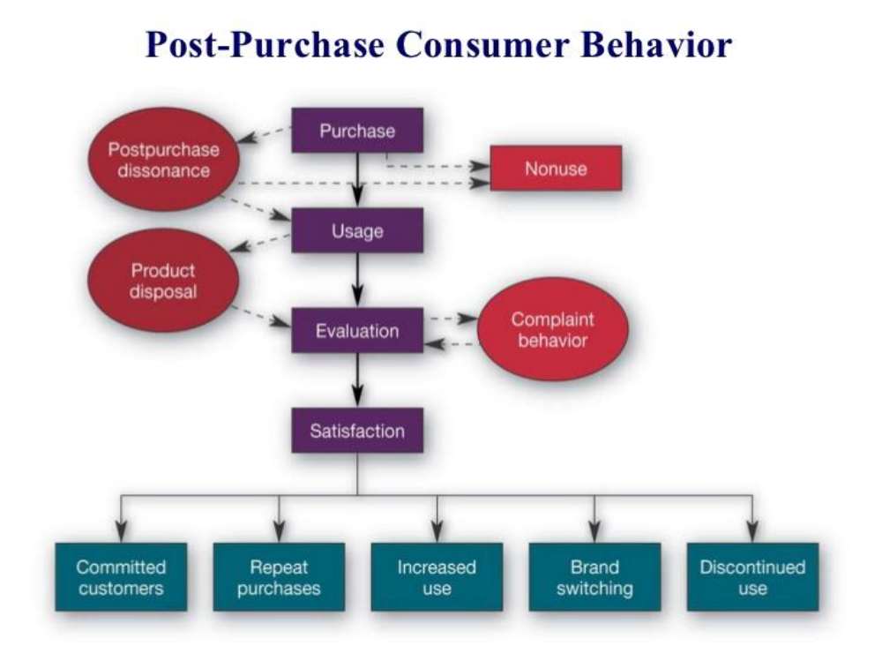

Slide 10
What is the meaning of post purchase dissonance?
Buyer's remorse. Post-Purchase Behavior is the stage of the Buyer Decision Process when a consumer will take additional action, based purely on their satisfaction or dissatisfaction
Post-Purchase Behavior: All the activities and experiences that follow purchase are included in the post purchase behavior. Usually, after making a purchase, consumers experience post-purchase dissonance. They sometimes regret their decisions made. It mainly occurs due to a large number of alternatives available, good performance of alternatives or attractiveness of alternatives, etc.
The marketers sometimes need to assure the consumer that the choice made by them is the right one. The seller can mention or even highlight the important features or attributes and benefits of the product to address and solve their concerns if any. A high level of post-purchase dissonance is negatively related to the level of satisfaction which the consumer draws out of product usage. To reduce post-purchase dissonance, consumers may sometimes even return or exchange the product.

Slide 11
Buying Process . A buying process is the series of steps that a consumer will take to make a purchasing decision. A standard model of consumer purchase decision-making includes recognition of needs and wants, information search, evaluation of choices, purchase, and post-purchase evaluation.
Far too often, retailers think that consumer buying is randomized. That certain products appeal to certain customers and that a purchase either happens or it doesn’t. They approach product and service marketing in the same way, based on trial and error. What if there were a distinctive set of steps that most consumers went through before deciding whether to make a purchase or not? What if there was a scientific method for determining what goes into the buying process that could make marketing to a target audience more than a shot in the dark? The good news? It does exist. The actual purchase is just one step. In fact, there are six stages to the consumer buying process, and as a marketer, you can market to them effectively.

Slide 12
